Slide 1
COIT20258 Software Engineering
Week 8
Software Evolution

Slide 2
Topics
Evolution processes
Legacy systems
Software maintenance

Slide 3
Life-cycle vs Evolution
Evolution
“Small changes over many generations”

Slide 4
Software Change
Software change is inevitable because:
  New requirements emerge when the software is used
  The business environment changes
  Errors must be repaired
  New computers & equipment is added to the system
  The performance or reliability of the system may have to be improved
A key problem for all organizations is implementing & managing change to their existing software systems

Slide 5
Importance of Evolution
Organizations have huge investments in their software systems - they are critical business assets
To maintain the value of these assets to the business, they must be changed & updated
The majority of the software budget in large companies is devoted to changing & evolving existing software rather than developing new software

Slide 6
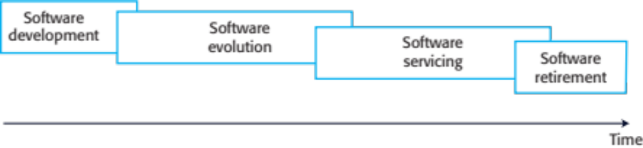
Evolution & Servicing

Slide 7
… Evolution & Servicing
Evolution
  New features or requirements are added to the system that results in a new version release
Servicing
  At this stage, the software remains useful but the only changes made are those required to keep it operational i.e. bug fixes & changes to reflect changes in the software’s environment. No new functionality is added.
Phase-out (retirement)
  The software may still be used but no further changes are made to it

Slide 8
Evolution Processes
Proposals for change are the driver for system evolution
  Should be linked with components that are affected by the change, thus allowing the cost & impact of the change to be estimated
Change identification & evolution continues throughout the system lifetime

Slide 9
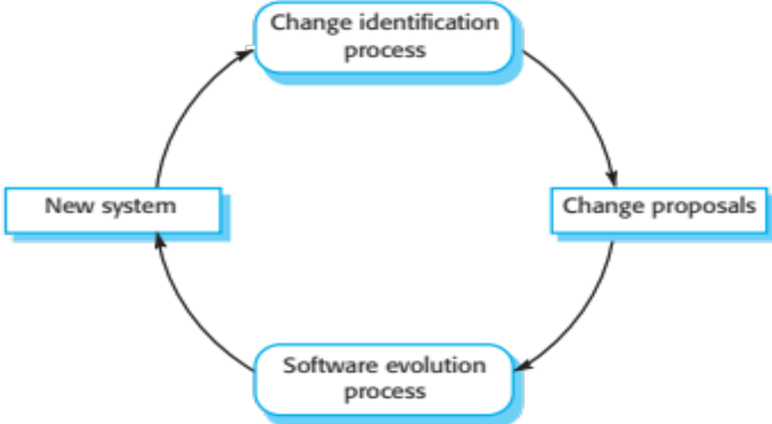
Change Identification & Evolution Processes

Slide 10
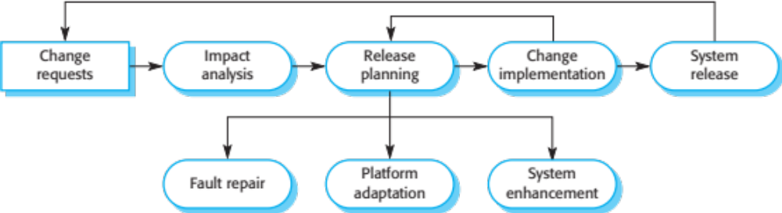
The Software Evolution Process

Slide 11
Urgent Change Requests
Urgent changes may have to be implemented without going through all stages of the software engineering process
  If a serious system fault has to be repaired to allow normal operation to continue
  If changes to the system’s environment (e.g., an OS upgrade) have unexpected effects
  If there are business changes that require a very rapid response (e.g. the release of a competing product)

Slide 12
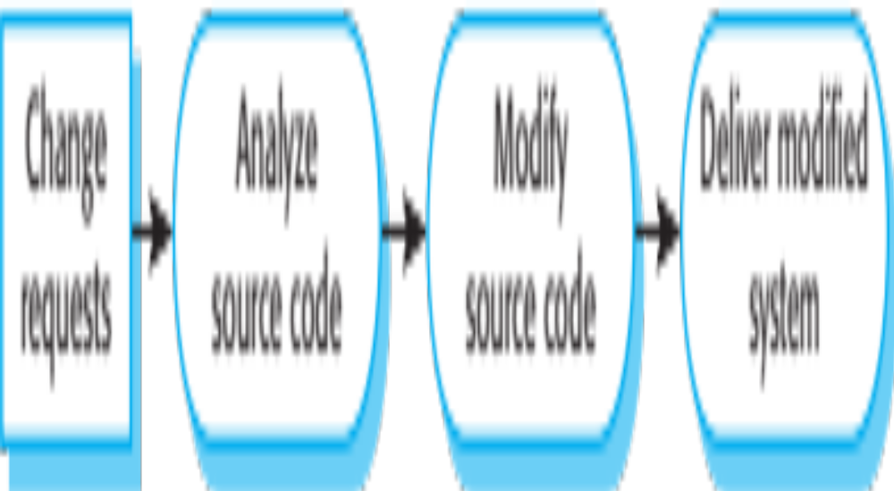
The Emergency Repair Process

Slide 13
Agile Methods & Evolution
Agile methods are based on incremental development so the transition from development to evolution is a seamless one
  Evolution is simply a continuation of the development process based on frequent system releases
Changes may be expressed as additional user stories

Slide 14
Legacy Systems
Legacy systems are older systems that rely on languages & technology that are no longer used for new systems development
Legacy software may be dependent on older hardware, such as mainframe computers & may have associated legacy processes & procedures

Slide 15
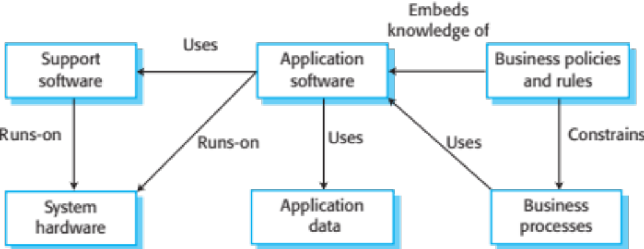
The Elements of a Legacy System

Slide 16
Legacy System Components
System hardware - Legacy systems may have been written for hardware that is no longer available
Support software - The legacy system may rely on a range of support software, which may be obsolete or unsupported
Application software - The application system that provides the business services is usually made up of a number of application programs
Application data - These are data that are processed by the application system. They may be inconsistent, duplicated, or held in different databases.

Slide 17
… Legacy System Components
Business processes - These are processes that are used in the business to achieve some business objective
  Business processes may be designed around a legacy system & constrained by the functionality that it provides
Business policies & rules - These are definitions of how the business should be carried out & constraints on the business. Use of the legacy application system may be embedded in these policies & rules.

Slide 18
Legacy System Replacement
Legacy system replacement is risky & expensive, so businesses continue to use these systems
System replacement is risky for several reasons:
  Lack of complete system specification
  Tight integration of system & business processes
  Undocumented business rules embedded in the legacy system
  New software development may be late &/or over budget

Slide 19
Legacy System Change
Legacy systems are expensive to change due to several reasons:
  No consistent programming style
  Use of obsolete programming languages with few people available with these language skills
  Inadequate system documentation
  System structure degradation
  Program optimizations may make them hard to understand
  Data errors, duplication, & inconsistency

Slide 20
Legacy System Management
Organizations that rely on legacy systems must choose a strategy for evolving these systems
  Scrap the system completely & modify business processes so that it is no longer required
  Continue maintaining the system
  Transform the system by re-engineering to improve its maintainability
  Replace the system with a new system
The strategy chosen should depend on the system quality & its business value

Slide 21
Legacy System Categories
Low quality, low business value
  These systems should be scrapped
Low-quality, high-business value
  These make an important business contribution but are expensive to maintain. Should be re-engineered or replaced if a suitable system is available.
High-quality, low-business value
  Replace with COTS (commercial-off-the-shelf), scrap completely or maintain
High-quality, high business value
  Continue in operation using normal system maintenance

Slide 22
Business Value Assessment
Assessment involves the following stakeholders:
  System end-users
  Business customers
  Line managers
  IT managers
  Senior managers
Interview different stakeholders & collate results

Slide 23
Issues in Business Value Assessment
The use of the system
  If systems are only used occasionally or by a small number of people, they may have a low business value
The business processes that are supported
  A system may have a low business value if it forces the use of inefficient business processes
System dependability
  If a system is not dependable & the problems directly affect business customers, the system has a low business value
The system outputs
  If the business depends on system outputs, then the system has a high business value

Slide 24
System Quality Assessment
Business process assessment
  How well does the business process support the current goals of the business?
Environment assessment
  How effective is the system’s environment & how expensive is it to maintain?
Application assessment
  What is the quality of the application software system?

Slide 25
Business Process Assessment
Use a viewpoint-oriented approach & seek answers from system stakeholders
  Is there a defined process model & is it followed?
  Do different parts of the organisation use different processes for the same function?
  How has the process been adapted?
  What are the relationships with other business processes & are these necessary?
  Is the process effectively supported by the legacy application software?

Slide 26
Factors Used in Environment Assessment
Factor | Questions
Supplier stability | Is the supplier still in existence? Is the supplier financially stable & likely to continue in existence? If the supplier is no longer in business, does someone else maintain the systems?
Failure rate | Does the hardware have a high rate of reported failures? Does the support software crash & force system restarts?
Age | How old is the hardware & software? The older the hardware & support software, the more obsolete it will be. It may still function correctly but there could be significant economic & business benefits to moving to a more modern system.
Performance | Is the performance of the system adequate? Do performance problems have a significant effect on system users?

Slide 27
… Factors Used in Environment
Assessment
Factor | Questions
Support requirements | What local support is required by the hardware & software? If there are high costs associated with this support, it may be worth considering system replacement.
Maintenance costs | What are the costs of hardware maintenance & support software licences? Older hardware may have higher maintenance costs than modern systems. Support software may have high annual licensing costs.
Interoperability | Are there problems interfacing the system to other systems? Can compilers, for example, be used with current versions of the operating system? Is hardware emulation required?

Slide 28
Factors Used in Application Assessment
Factor | Questions
Understandability | How difficult is it to understand the source code of the current system? How complex are the control structures that are used? Do variables have meaningful names that reflect their function?
Documentation | What system documentation is available? Is the documentation complete, consistent, & current?
Data | Is there an explicit data model for the system? To what extent is data duplicated across files? Is the data used by the system up to date & consistent?
Performance | Is the performance of the application adequate? Do performance problems have a significant effect on system users?

Slide 29
… Factors Used in Application Assessment
Factor | Questions
Programming language | Are modern compilers available for the programming language used to develop the system? Is the programming language still used for new system development?
Configuration management | Are all versions of all parts of the system managed by a configuration management system? Is there an explicit description of the versions of components that are used in the current system?
Test data | Does test data for the system exist? Is there a record of regression tests carried out when new features have been added to the system?
Personnel skills | Are there people available who have the skills to maintain the application? Are there people available who have experience with the system?

Slide 30
System Measurement
You may collect quantitative data to make an assessment of the quality of the application system
  The number of system change requests: The higher this accumulated value, the lower the quality of the system
  The number of different user interfaces used by the system: The more interfaces, the more likely it is that there will be inconsistencies & redundancies in these interfaces
  The volume of data used by the system: As the volume of data (number of files, size of database, etc.) processed by the system increases, so too do the inconsistencies & errors in that data.
    Cleaning up old data is a very expensive & time-consuming process

Slide 31
Software Maintenance
Modifying a program after it has been put into use
The term is mostly used for changing custom software. Generic software products are said to evolve to create new versions.
Maintenance does not normally involve major changes to the system’s architecture
Changes are implemented by modifying existing components & adding new components to the system

Slide 32
Types of Maintenance
Fault repairs
  Changing a system to fix bugs/vulnerabilities & correct deficiencies in the way meets its requirements
Environmental adaptation
  Maintenance to adapt software to a different operating environment
  Changing a system so that it operates in a different environment (e.g., computer & OS) from its initial implementation
Functionality addition & modification
  Modifying the system to satisfy new requirements

Slide 33
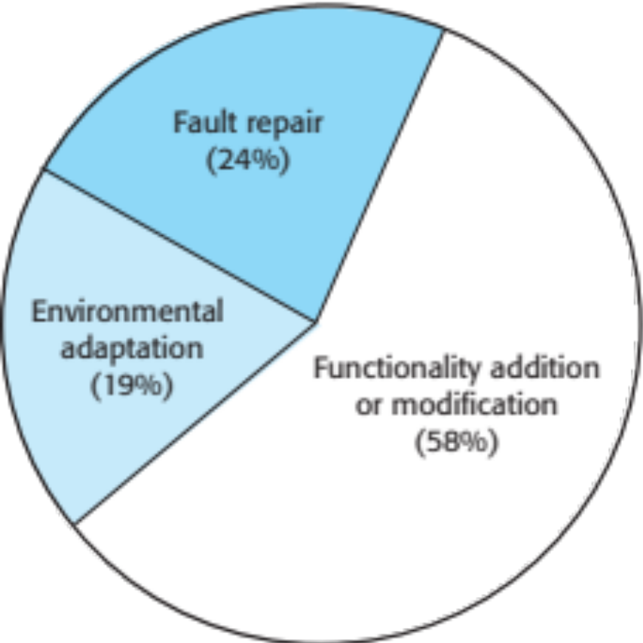
Maintenance Effort Distribution

Slide 34
Maintenance Costs
Usually greater than development costs
Affected by both technical & non-technical factors
Increases as software is maintained.
Maintenance corrupts the software structure so makes further maintenance more difficult.
Aging software can have high support costs (e.g., old languages & compilers)

Slide 35
… Maintenance Costs
It is usually more expensive to add new features to a system during maintenance than it is to add the same features during development
  A new team has to understand the programs being maintained
  Separating maintenance & development means there is no incentive for the development team to write maintainable software
  Program maintenance work is unpopular
    Maintenance staff are often inexperienced & have limited domain knowledge
  As programs age, their structure degrades & they become harder to change

Slide 36
Maintenance Prediction
Maintenance prediction is concerned with assessing which parts of the system may cause problems & have high maintenance costs
  Change acceptance depends on the maintainability of the components affected by the change
  Implementing changes degrades the system & reduces its maintainability
  Maintenance costs depend on the number of changes & costs of change depend on maintainability

Slide 37
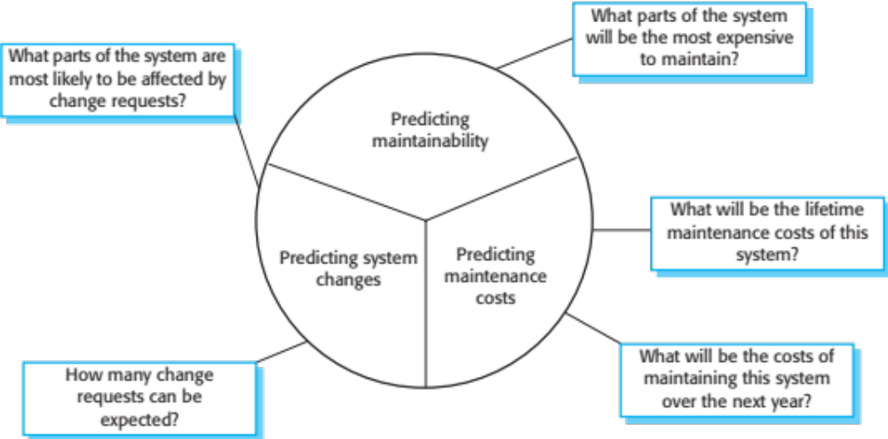
… Maintenance Prediction

Slide 38
Complexity Metrics
Predictions of maintainability can be made by assessing the complexity of system components
Studies have shown that most maintenance effort is spent on a relatively small number of system components
Complexity depends on:
  Complexity of control structures
  Complexity of data structures
  Object, method (procedure) & module size

Slide 39
Process Metrics
Process metrics may be used to assess maintainability
  Number of requests for corrective maintenance
  Average time required for impact analysis
  Average time taken to implement a change request
  Number of outstanding change requests
If any or all of these is increasing, this may indicate a decline in maintainability

Slide 40
Refactoring
Refactoring is the process of making improvements to a program to slow down degradation through change
You can think of refactoring as “preventative maintenance” that reduces the problems of future change
Refactoring involves modifying a program to improve its structure, reduce its complexity or make it easier to understand
When you refactor a program, you should not add functionality but rather concentrate on program improvement

Slide 41
“Bad Smells” in Program Code
Duplicate code
  The same or very similar code may be included at different places in a program. This can be removed & implemented as a single method or function that is called as required.
Long methods
  If a method is too long, it should be redesigned as a number of shorter methods
Switch (case) statements
  These often involve duplication, where the switch depends on the type of a value. The switch statements may be scattered around a program. In object-oriented languages, you can often use polymorphism to achieve the same thing.

Slide 42
… “Bad Smells” in Program Code
Data clumping
  Data clumps occur when the same group of data items (fields in classes, parameters in methods) re-occur in several places in a program. These can often be replaced with an object that encapsulates all these data.
Speculative generality
  This occurs when developers include generality in a program in case it is required in the future. This can often simply be removed.

Slide 43
Key Points
Software development & evolution can be thought of as an integrated, iterative process that can be represented using a spiral model
For custom systems, the costs of software maintenance usually exceed the software development costs
The process of software evolution is driven by requests for changes & includes change impact analysis, release planning & change implementation
Legacy systems are older software systems, developed using obsolete software & hardware technologies, that remain useful for a business

Slide 44
… Key Points
It is often cheaper & less risky to maintain a legacy system than to develop a replacement system using modern technology
The business value of a legacy system & the quality of the application should be assessed to help decide if a system should be replaced, transformed or maintained
There are 3 types of software maintenance, namely bug fixing, modifying software to work in a new environment, & implementing new or changed requirements

Slide 45
… Key Points
Refactoring, making program changes that preserve functionality, is a form of preventative maintenance

Slide 46
* * * End ***

